Slide 2

Risk Management System
August 2019
IMP

Slide 3
Agenda
Introduction
Deliverables
Technology Stack
4+1 Architectural View
Implementation
Notes:
Let’s talk about writing…

Slide 4
Introduction
Problem Statement : Companies usually apply for credit with organizations like banks or other companies in day to day life. The companies which lend credit have to cautiously assess risk associated with the credit.
Solution : Risk Management System is a web application where companies can check credit score.This application can be used by multiple users like companies who want to apply for credit,organization which lends credit and financial analyst who can evaluate applications of users.
Different types of users who will interact with system:
Admin
Lender
Borrower
Financial Analyst
Notes:
Let’s talk about writing…

Slide 5
Deliverables
Lender and Borrower can register to the system.
Lender can customize the policies.
Lender can view all the credit requests submitted to the organization.
Lender can add financial analyst and can assign credit requests to its analysts.
Borrower can view the list of lenders with their description.
Borrower can fill the credit application form of any lender.
Borrower can view previous credit history.
Financial Analyst can approve or reject the received application requests.
System notifies the users about the status of application.
Notes:
One slide, one idea.
How it works, what the benefits are, what it is, all on one slide.

Slide 6
Technology Stack
Presentation Layer
Angular 4
Bootstrap 4
Business Layer :
Spring Boot - Version 2.1.6
Security - spring-boot-starter-security , JWT
Scheduler - spring scheduler
Build tool - Maven
Mail - spring-boot-starter-mail, Gmail SMTP
logger - log4j
Test Framework : Junit , Mockito
Data Access Layer : JPA, Hibernate
Data Storage : MySQL 5.7.26
Notes:
One slide, one idea.
How it works, what the benefits are, what it is, all on one slide.

Slide 7
4+1 Architectural View
Scenario View : Use Case Diagram
Process View : Activity Diagram
Logical View : ER Diagram
Development View : Component Diagram
Physical View : Deployment Diagram

Slide 8
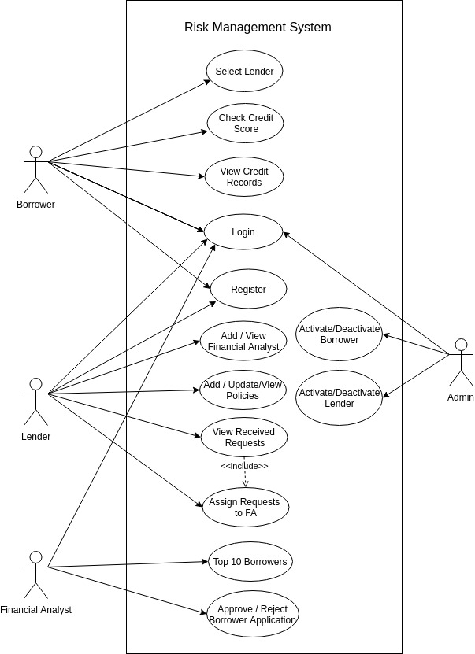
Use Case Diagram

Slide 9
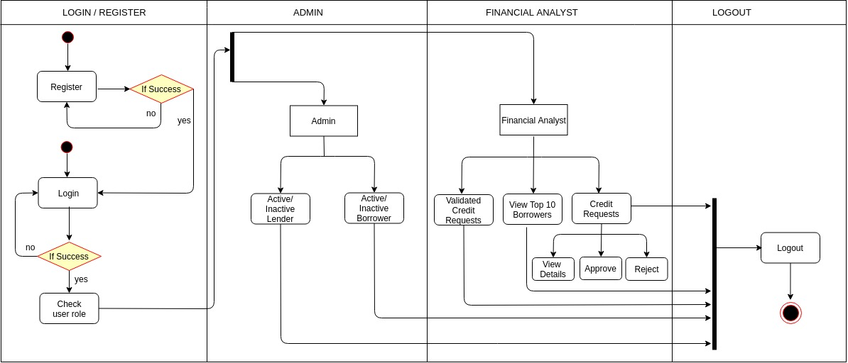
Activity Diagram

Slide 10
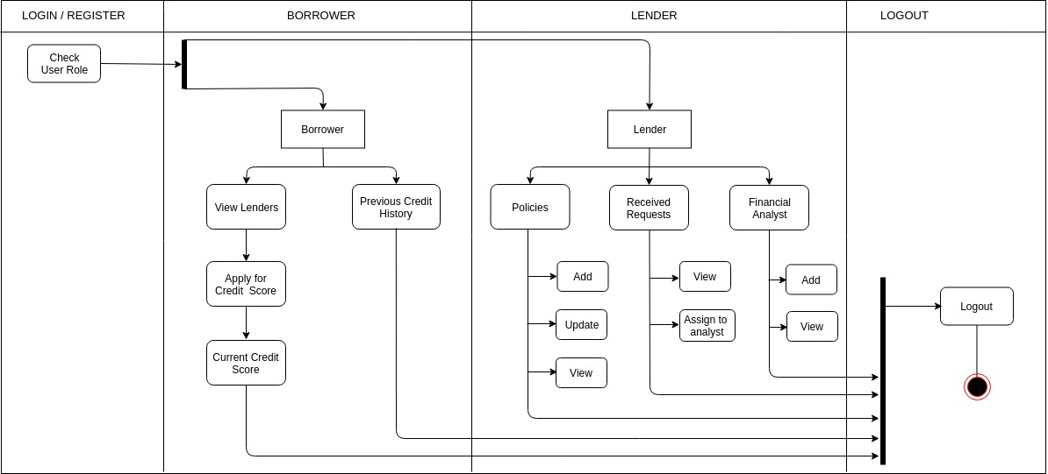
Activity Diagram

Slide 11
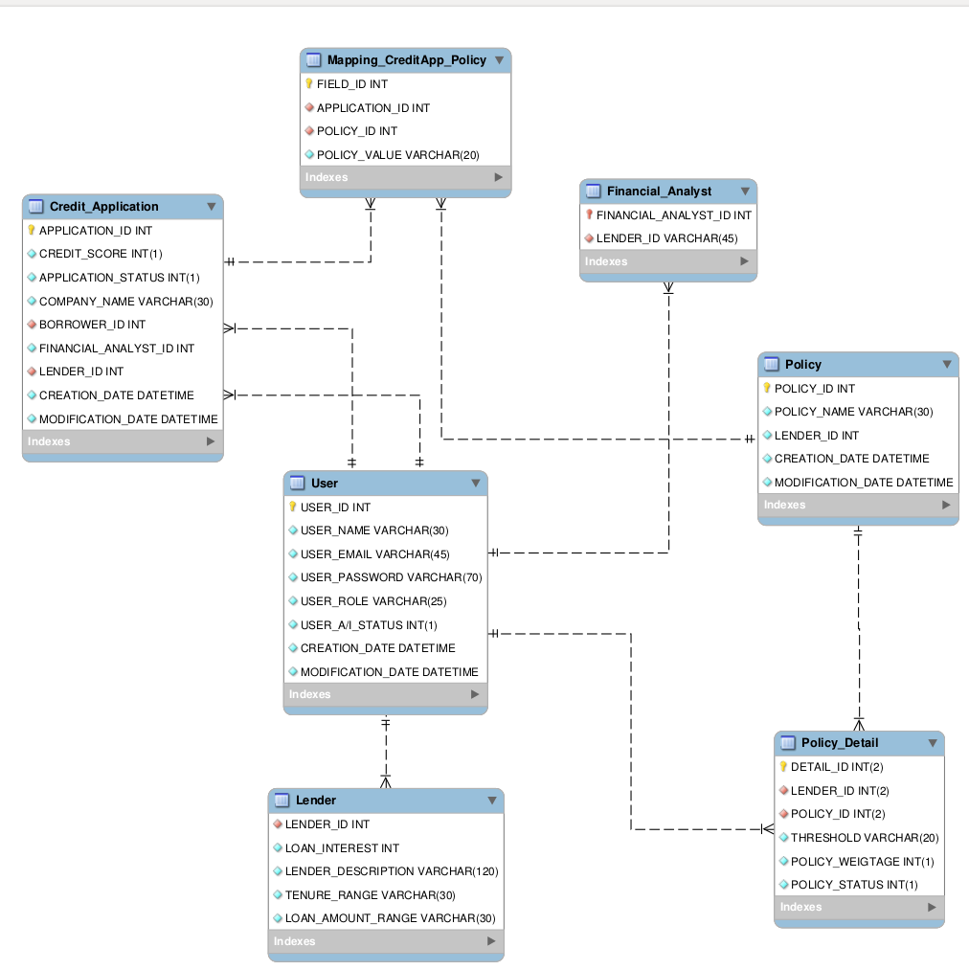
ER Diagram

Slide 12
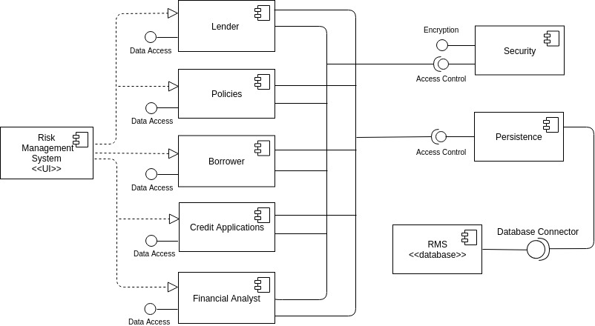
Component Diagram

Slide 13
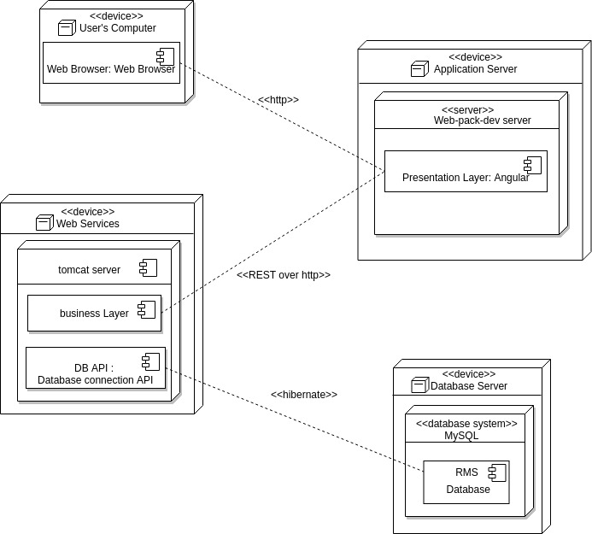
Deployment Diagram

Slide 14
IMPLEMENTATION

Slide 15
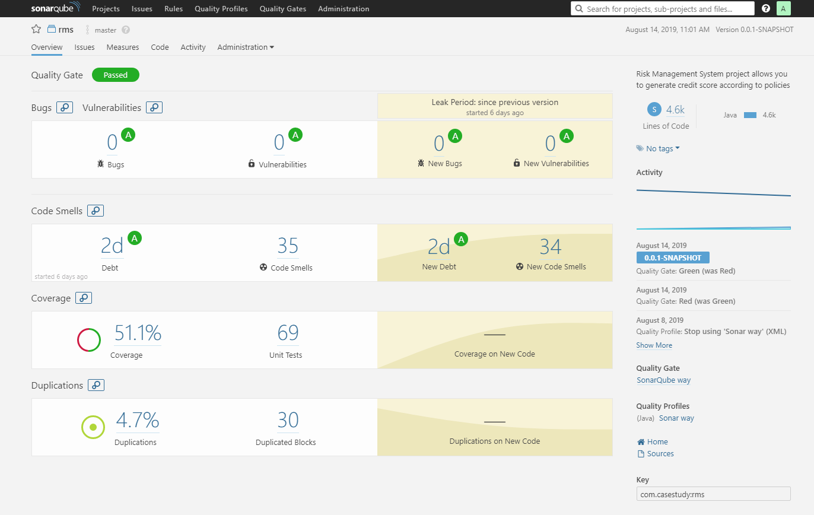
Sonar Report

Slide 16
Changes
ER diagram correction
Analyst should be able to view the formula.
Password Encryption in network.
Swagger
Static Code Analysis Report of UI
Sonar Report of Backend
Decrease the Complexity

Slide 17
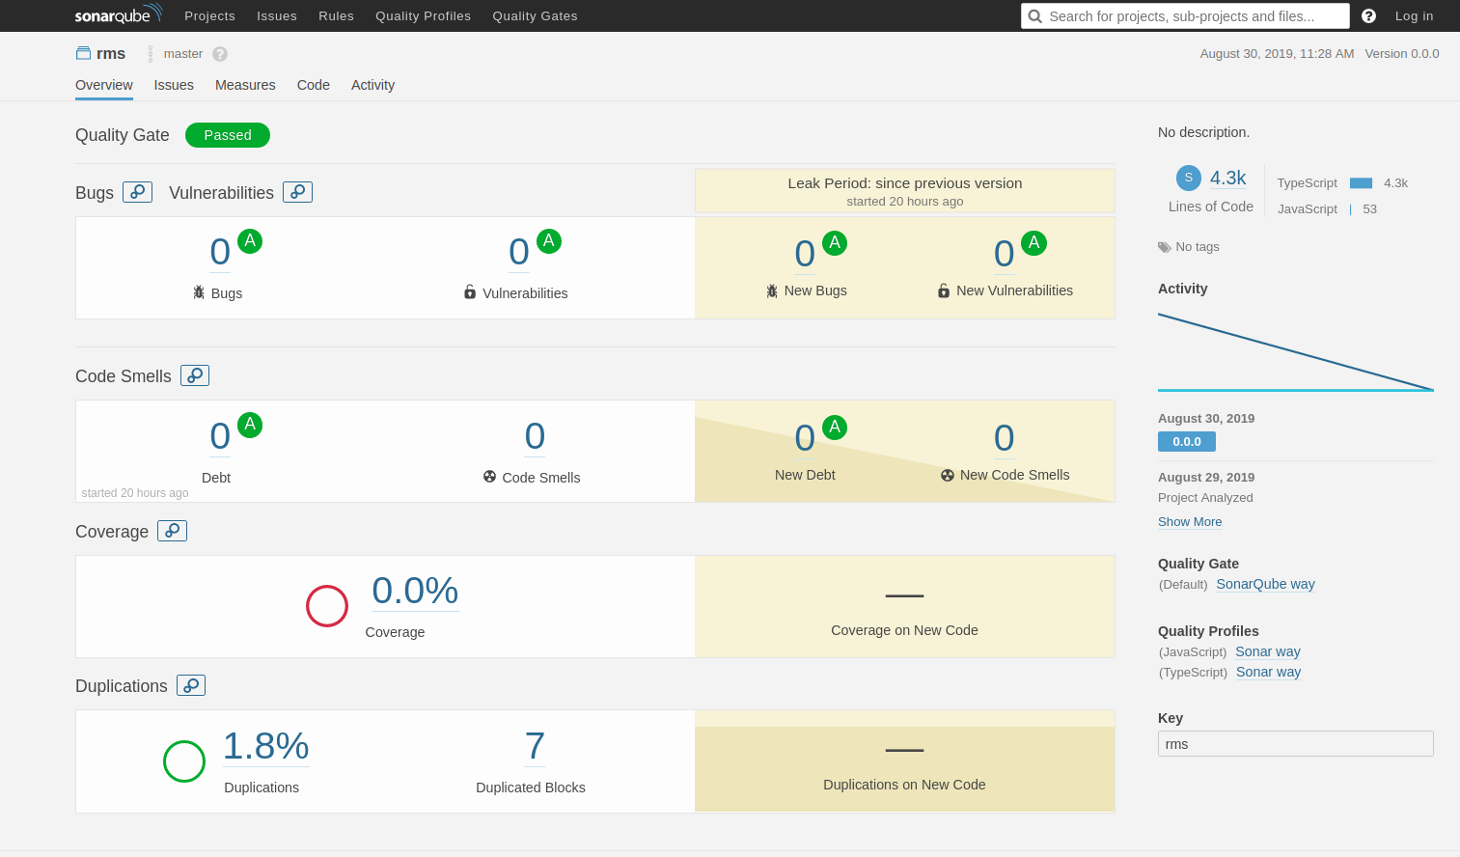
Static Code Analysis Report of UI

Slide 18
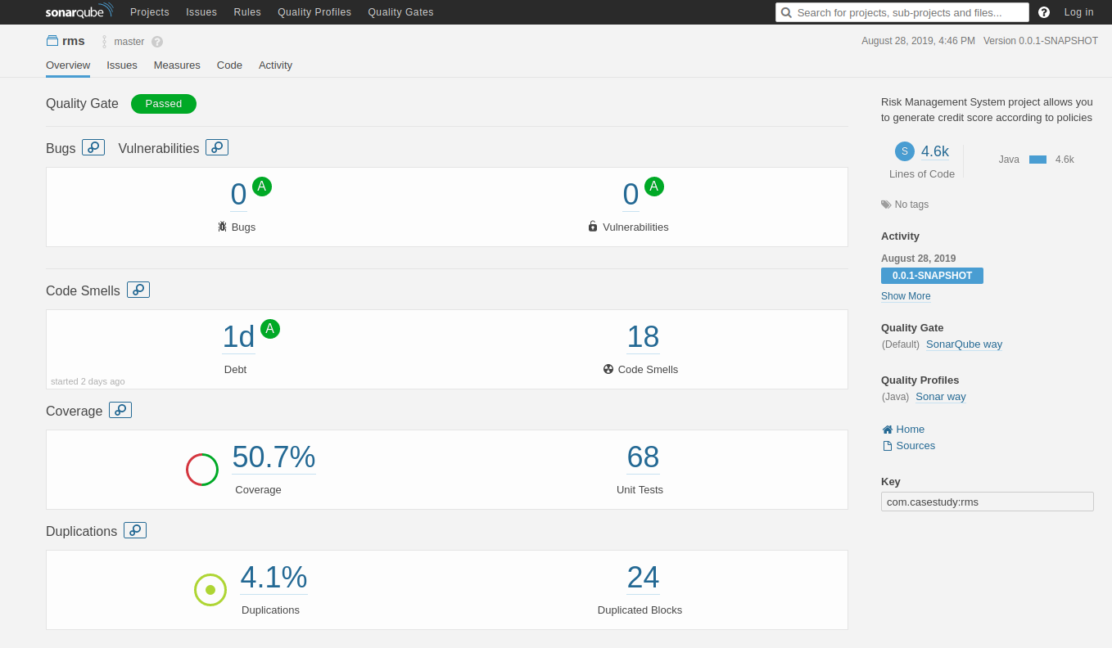
Sonar Report of Backend

Slide 19
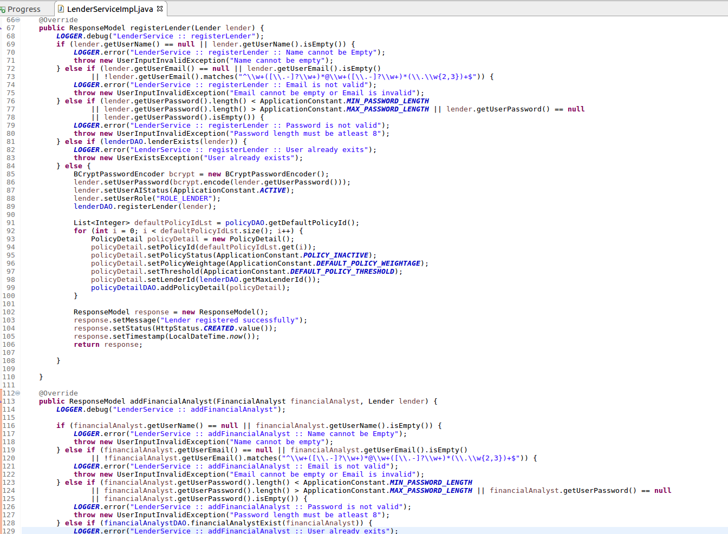
Previous Code Snippet

Slide 20
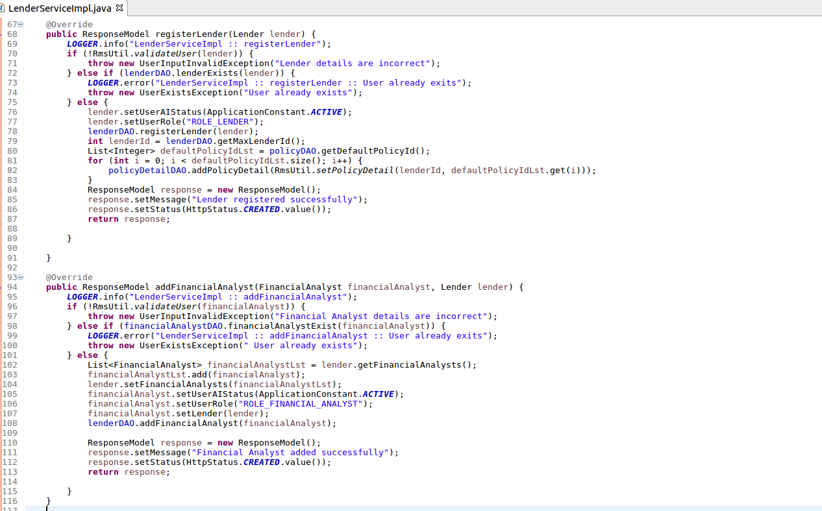
New Code Snippet

Slide 21
Thanks.

